Slide 1
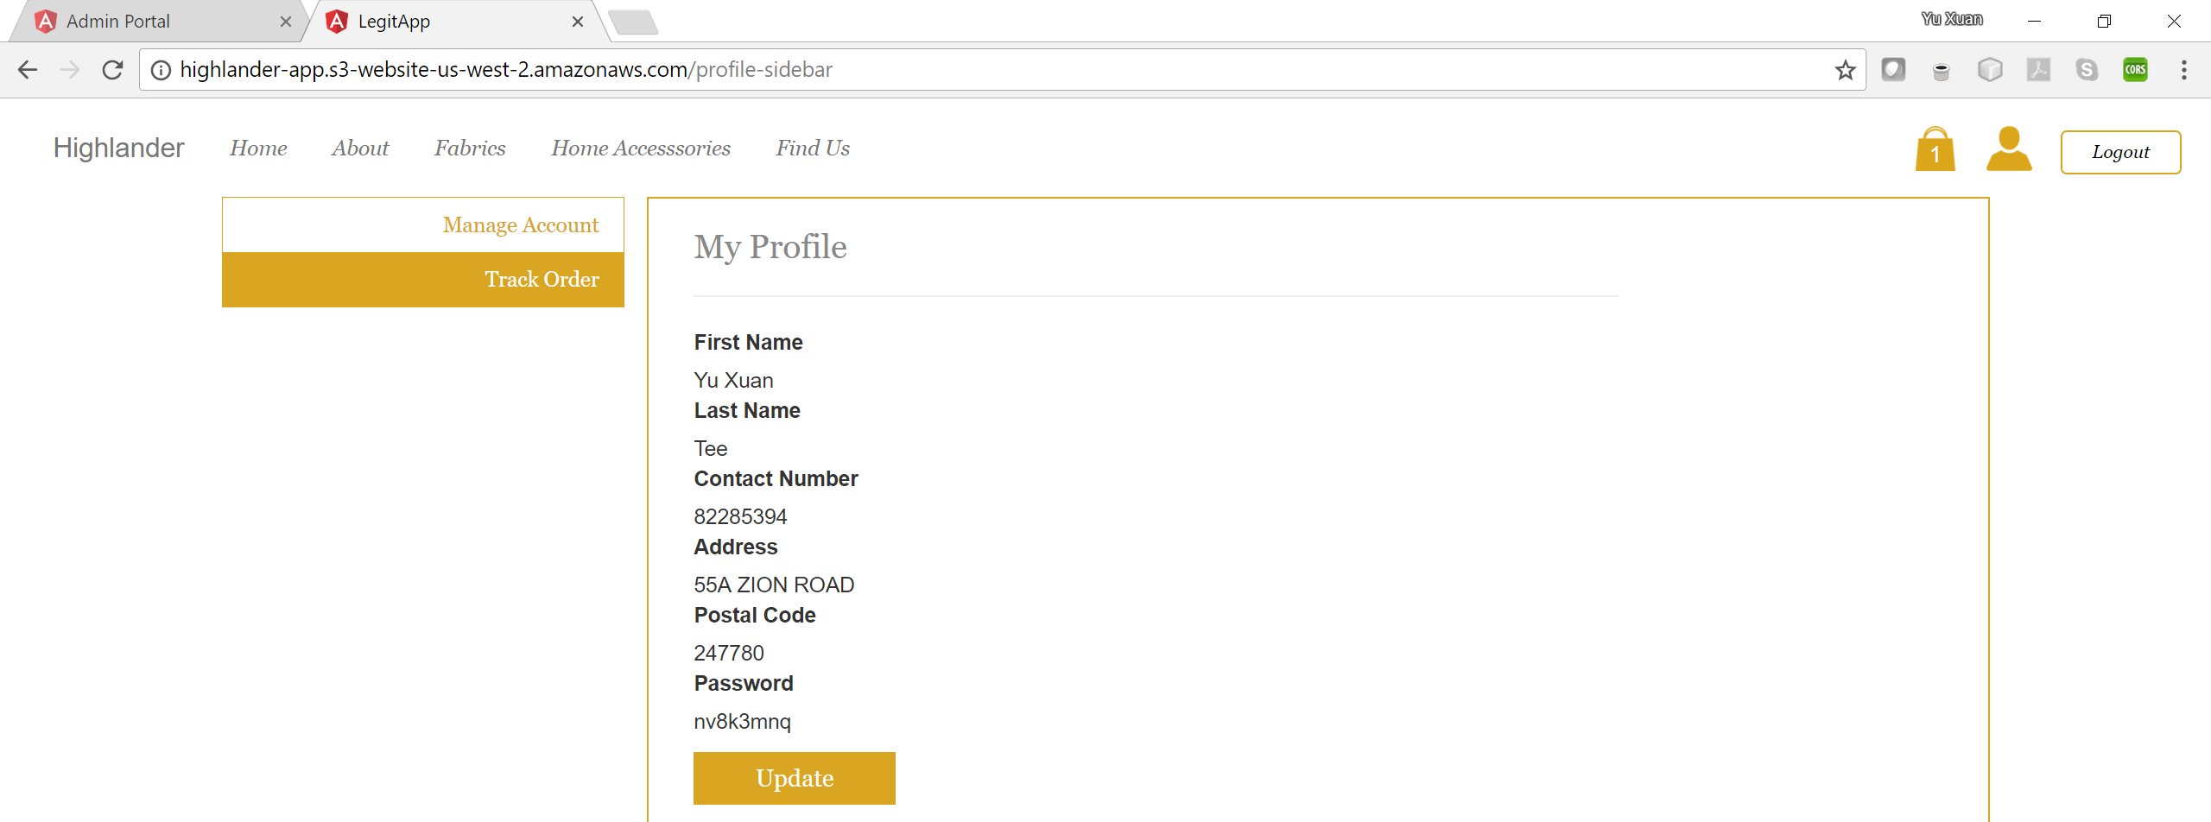
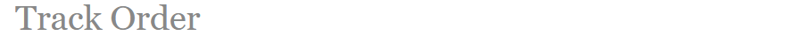
Current Orders
Order ID | Order Status | Price | Data of Purchase
#005 | Payment Received | $400.00 | 1st August 2017
#006 | Packaging | $350.50 | 1st August 2017
#007 | Packaging | $450.00 | 1st August 2017
#008 | In Transit | $749.90 | 1st August 2017
Past Purchases
Order ID | Delivery Date | Price | Date of Purchase
#001 | 25th June 2017 | $400.00 | 15th June 2017
#002 | 25th June 2017 | $350.50 | 15th June 2017
#003 | 25th June 2017 | $450.00 | 15th June 2017
#004 | 25th June 2017 | $749.90 | 15th June 2017

Slide 2
Current Orders
No orders in process
Past Purchases
Order ID | Delivery Date | Price | Date of Purchase
#001 | 25th June 2017 | $400.00 | 15th June 2017
#002 | 25th June 2017 | $350.50 | 15th June 2017
#003 | 25th June 2017 | $450.00 | 15th June 2017
#004 | 25th June 2017 | $749.90 | 15th June 2017

Slide 3
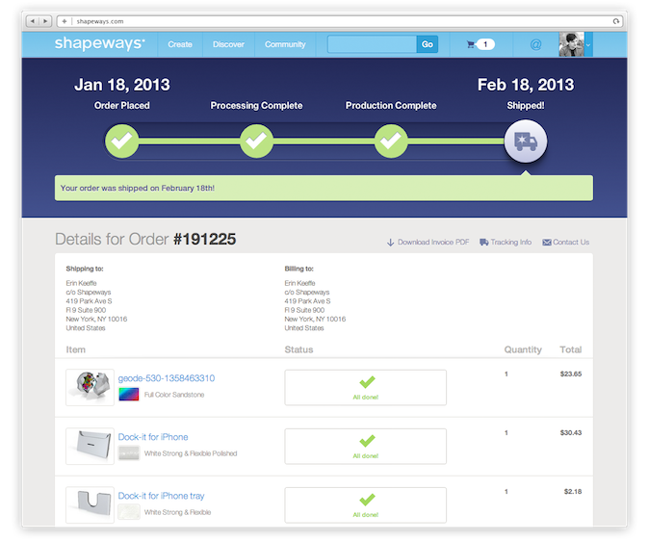
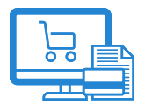


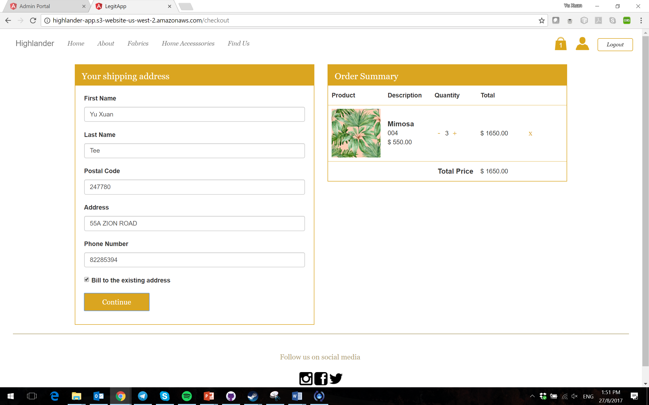
Details for Order Number: [order no]
Shipping Tracking Number: [courier shipping tracking number]
Delivery Address: [Address], [Country] [Postal Code]
[order date]
[delivered date]
Preparing Your Order
Preparing for Shipment
In Transit
Processing Order
Packaging
Order Delivered

Slide 4
Details for Order Number: #12345
Shipping Tracking Number: NinjaVan1234
Delivery Address: 55A Zion Road, Singapore 247780
27 Aug, 2017
30 Aug, 2017
Preparing Your Order
Preparing for Shipment
In Transit
Payment Received
Packaging
Order Delivered

Slide 5
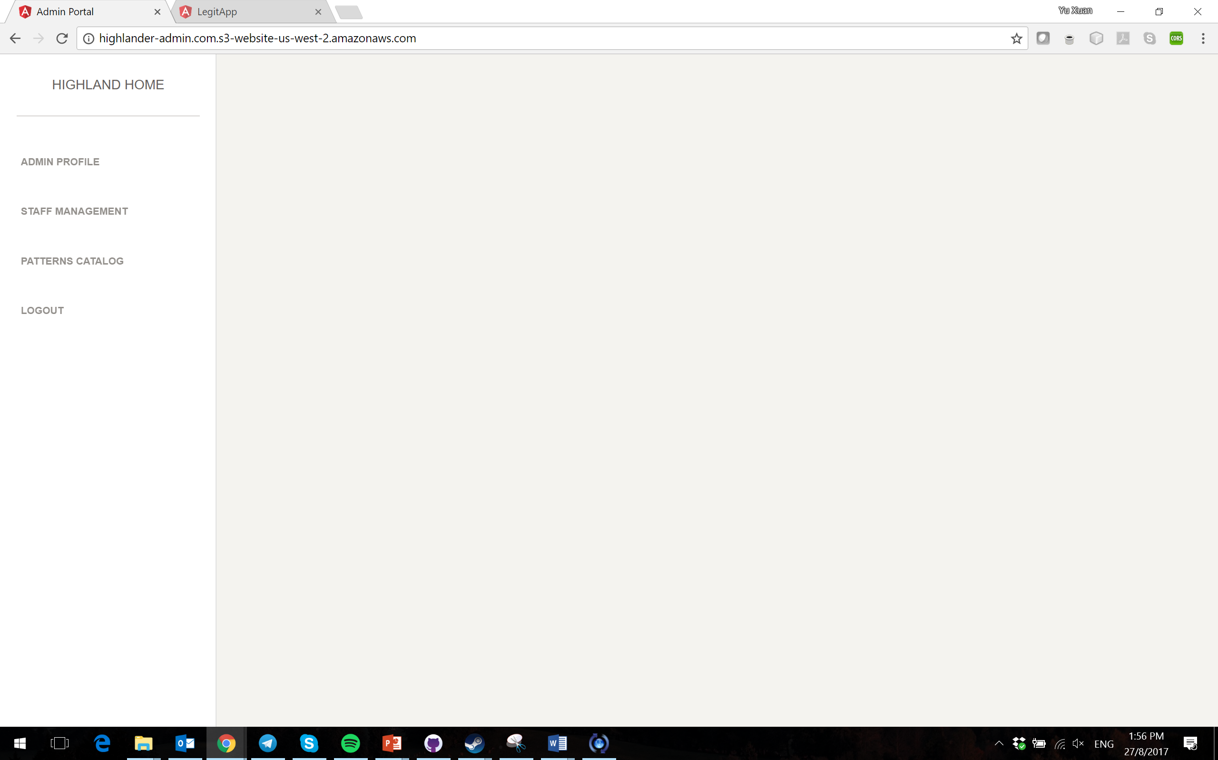
Order Management Dashboard
Drop down Filters: [Date (Newest undelivered)], [Date (Oldest undelivered)], [Status]
Search: [By order ID]
All
New Orders
Production
Packaging
Shipping
Completed
Order Number | Status | Courier | Shipping Tracking Number | Order Total Price | Customer Email |  | Contact Number
#001 | In Transit
#002 | In Transit
#003 | Preparing to Ship
#004 | Packaging
#005 | Production
#006 | Production
#007 | Waiting for Confirmation
#008 | Waiting for Confirmation
Filterable, Searchable, Selectable
Page number / Show 100 out of all orders

Slide 6



Order Process Tracking Dashboard
All
New Orders
Production
Packaging
Shipping
Completed
Order Number: #005
Delivery Address: 55A Zion Road, Singapore 247780
Return
Product
Type
Pattern
Material
Color
Size
Quantity
Bedding
P01 Tree
M01 Silk
C01 Pink
Queen
1
Bedding
P01 Tree
M01 Cotton
C01 Pink
Single
2

Slide 7
Order Management Dashboard
Drop down Filters: [Date (Newest undelivered)], [Date (Oldest undelivered)], [Status]
Search: [By order ID]
All
New Orders
Production
Packaging
Shipping
Completed
Order Number | Status | Courier | Shipping Tracking Number | Order Total Price | Customer Email |  | Contact Number
#001 | In Transit
#002 | In Transit
#003 | Preparing to Ship
#004 | Packaging
#005 | Production
#006 | Production
#007 | Waiting for Confirmation
#008 | Waiting for Confirmation
Filterable, Searchable, Selectable
Page number / Show 100 out of all orders

Slide 8
Order Process Tracking Dashboard
All
New Orders
Production
Packaging
Shipping
Completed
Order Number: #12345
Sends the process to next step, or previous step
Previous Process
Next Process
Preparing Your Order
Preparing for Shipment
In Transit
Processing Order
Packaging
Order Delivered
Return
Delivery Address: 55A Zion Road, Singapore 247780
Product
Type
Pattern
Material
Color
Size
Quantity
Only for Production, all products must be completed to proceed
Bedding
P01 Tree
M01 Silk
C01 Pink
Queen
1
Bedding
P01 Tree
M01 Cotton
C01 Pink
Single
2

Slide 9
Order Process Tracking Dashboard
All
New Orders
Production
Packaging
Shipping
Completed
Order Number: #12345
Previous Process
Next Process
Preparing Your Order
Preparing for Shipment
In Transit
Processing Order
Packaging
Order Delivered
Return
Delivery Address: 55A Zion Road, Singapore 247780
Shipment Tracking Number:
Must enter before next step, overwrites old tracking number
Product
Type
Pattern
Material
Color
Size
Quantity
Bedding
P01 Tree
M01 Silk
C01 Pink
Queen
1
Bedding
P01 Tree
M01 Cotton
C01 Pink
Single
2

Slide 10
Order Management Dashboard
Drop down Filters: [Date (Newest undelivered)], [Date (Oldest undelivered)], [Status]
Search: [By order ID]
All
New Orders
Production
Packaging
Shipping
Completed
Order Number | Status | Courier | Shipping Tracking Number | Order Total Price | Customer Email |  | Contact Number
#001 | In Transit
#002 | In Transit
#003 | Preparing to Ship
#004 | Packaging
#005 | Production
#006 | Production
#007 | Waiting for Confirmation
#008 | Waiting for Confirmation
Order Management
Page number / Show 100 out of all orders

Slide 11

Order Management Dashboard
Special Status Choice Available: Cancelled
Order Number: #0001
Status | Courier | Shipping Tracking Number | Order Total Price | Customer Email | Contact Number
In Transit | ShunFeng | A1234Z | $1000 | ha@gmail.com | 91234567
Payment Timestamp: 15th Oct 2017, 1430hrs
Stripe Charge ID: abc123456
Promo Code: OFF100
Order Management
Recipient Name: Tommy the Friend
Delivery Address: 55A Zion Road, Singapore 247780
Product
Pattern
Material
Color
Size
Quantity
Price
Bedding
P01 Tree
M01 Silk
C01 Pink
Queen
1
$1000

Slide 12
Customer Management Dashboard
Links to Order Management for that Customer order
Search: [By customer email, customer name, contact number]
Customer Name | Customer Email | Customer Orders | Customer Address | Contact Number
 | legit@gmail.com | #001, #002
 |  | #003
 |  | #004
 |  | #005,#010
Customer
Management
Links to Customer Management for that Customer
Page number / Show 100 out of all customers

Slide 13
Customer Management Dashboard
Links to Order Management for that Customer order
Customer Email: legit@gmail.com
First Name | Last name | Password | Customer Orders | Address | Postal Code | Contact Number
 |  | ***** | #001, #002
Customer
Management
Multiple Address List?

